Slide 1
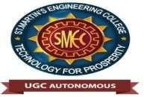

St. MARTIN’S ENGINEERING COLLEGE
UGC Autonomous
NBA & NAAC A+ ACCREDITED
Dhulapally, Secunderabad– 500100
DEPARTMENT OF ARTIFICIAL INTELLIGENCE & DATA SCIENCE
Mini Project on
“Hyderabad Metro Rail Commute Analytics”
Batch No: 14
1. M. SANDEEP KUMAR (23K81A7234)
2. M. KARTHIK (23K81A7235)
3. N. SHASHANK (23K81A7246)
Under the Guidance of
R.RAJESWARAN
ASSISTANT PROFESSOR
Department of AI&DS

Slide 2
OUTLINE
Title
Abstract
Overall Design (Architecture + WorkFlow Diagram)
Experimental Results
Conclusion
Future Enhancements
References
Impact of the Project
100% Code Implementation
Implementation Demo

Slide 3
ABSTRACT
This project proposes a Hyderabad Metro Rail Commute Analytics and Crowd Prediction System that combines machine learning and graph algorithms to improve metro travel efficiency. The system predicts passenger crowd levels at metro stations using a Long Short-Term Memory (LSTM) neural network, which analyzes historical crowd patterns to forecast future congestion levels categorized as Low, Medium, or High. The Hyderabad Metro network is modeled as a graph where stations represent nodes and travel times represent weighted edges. Dijkstra’s algorithm is applied to compute the shortest route between selected stations. An interactive dashboard developed using Streamlit and Plotly allows users to select source and destination stations, view optimal routes, and visualize predicted crowd levels through charts and metro route maps. The system demonstrates how predictive analytics can enhance urban transportation systems by helping commuters avoid crowded stations and make better travel decisions. This approach supports the development of intelligent, data-driven solutions for smart city transportation management.

Slide 4
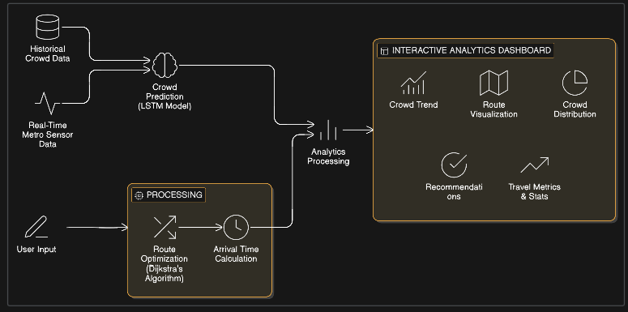
OVERALL DESIGN

Slide 5
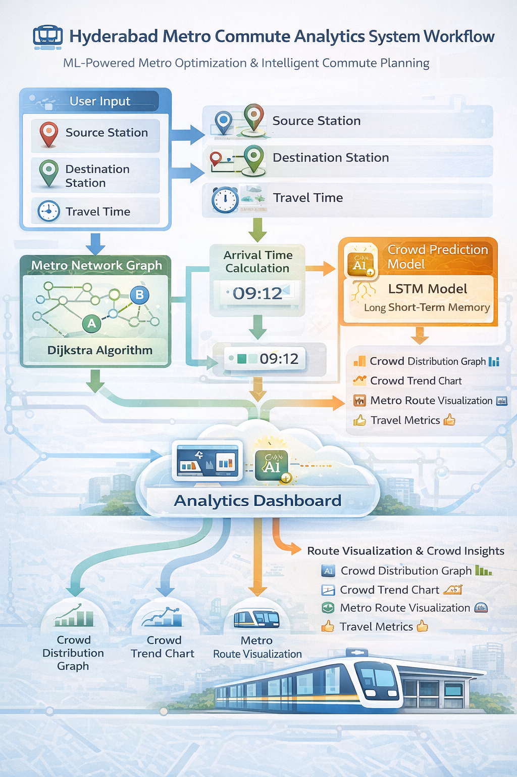

Slide 6
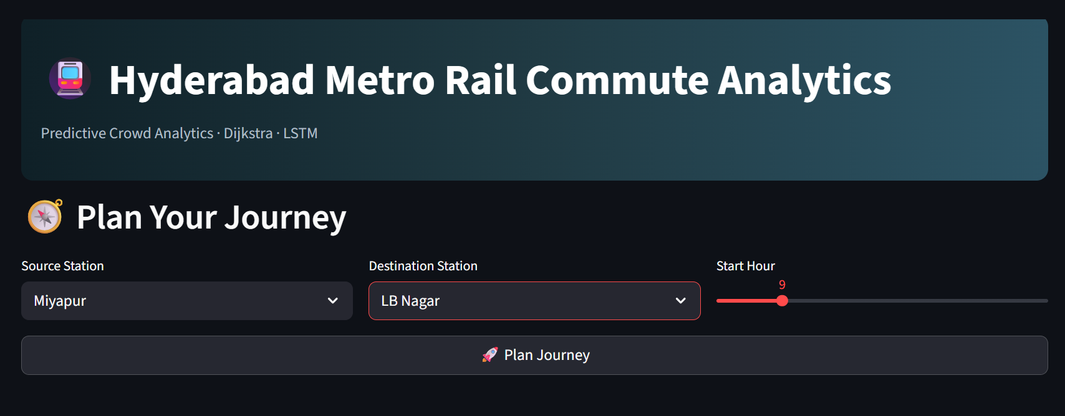
EXPERIMENTAL RESULTS

Slide 7
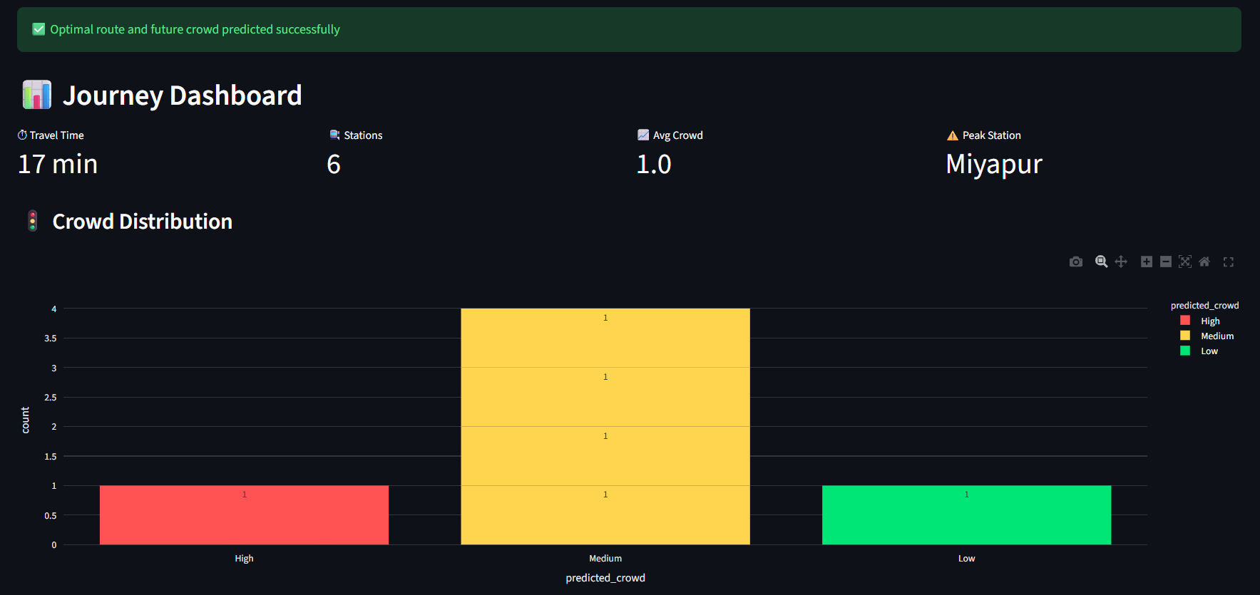

Slide 8
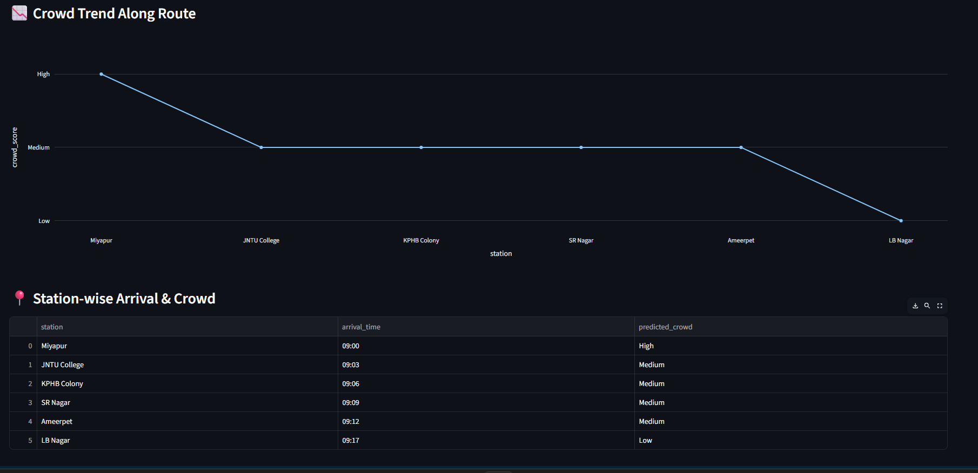
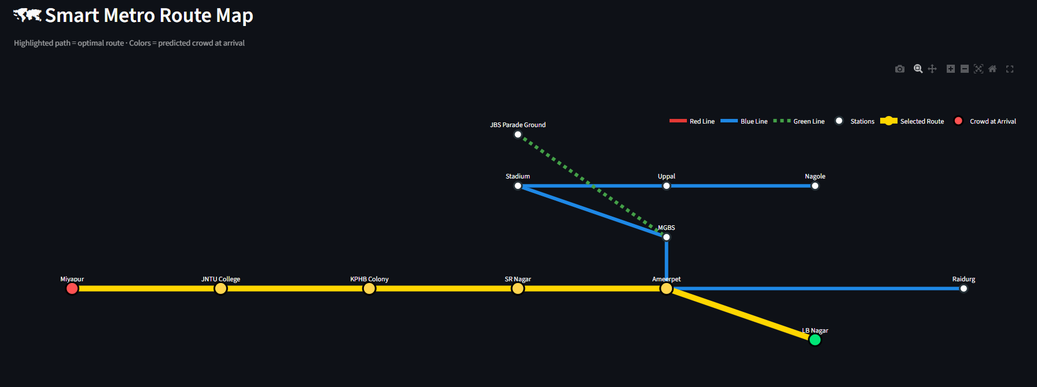

Slide 9
CONCLUSION
The project successfully demonstrates a predictive metro commute analytics system that combines machine learning and graph algorithms. The system predicts future crowd levels using an LSTM model and determines optimal routes using Dijkstra’s algorithm. The interactive dashboard helps passengers visualize commute insights and make better travel decisions.

Slide 10
FUTURE ENHANCEMENT
Integration with real metro smart-card data
Real-time crowd monitoring using IoT sensors
Mobile application deployment
Reinforcement learning for dynamic route optimization
Integration with Google Maps API

Slide 11
REFERENCES
Sharma and Verma (2025) analyzed smart transportation systems in Indian metro cities
Zhao et al. (2025) studied the use of smart card data to analyze passenger travel behavior in urban transport systems.
Yang et al. (2025) proposed optimization techniques for metro operations using passenger flow data.
Wu et al. (2024) applied deep learning models for predicting metro passenger crowd levels.
Chen et al. (2024) developed real-time crowd monitoring systems for urban metro stations.

Slide 12
CONTRIBUTION - IMPACT
This project demonstrates how AI and data analytics can improve public transportation systems.
Possible real-world applications include:
Smart metro commute planning
Passenger flow management
Crowd congestion prediction
Smart city transportation systems
Data-driven metro operations
Such systems can help cities build more efficient and intelligent urban transportation networks.
This project improves metro commuting by predicting passenger crowd levels and recommending optimal travel routes using machine learning and graph algorithms. It helps commuters avoid overcrowded stations and make better travel decisions.
The system benefits daily metro passengers and transportation planners by providing crowd analytics, route optimization, and visual insights, making metro travel more efficient and supporting smarter urban transportation systems

Slide 13
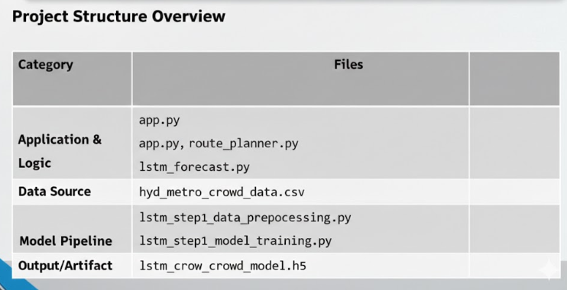
CODE STRUCTURE

Slide 14
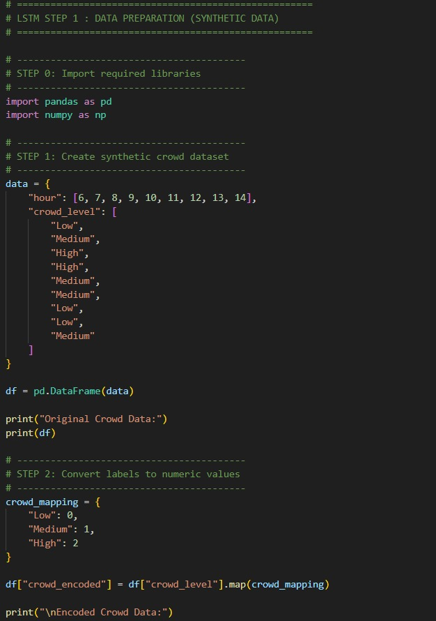
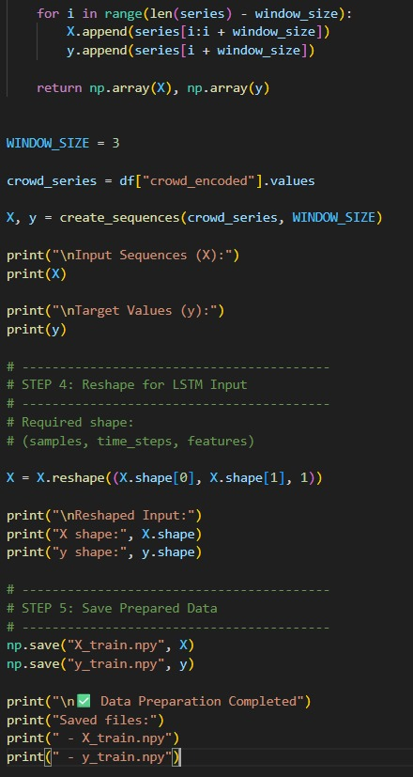
100 % CODE IMPLEMENTATION
DATA PREPARATION

Slide 15
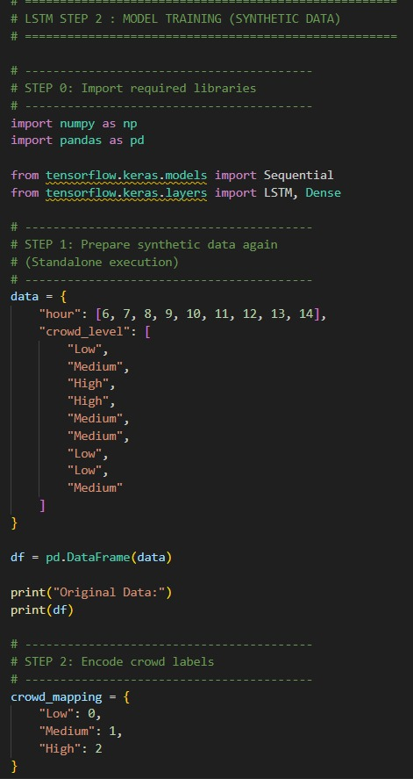
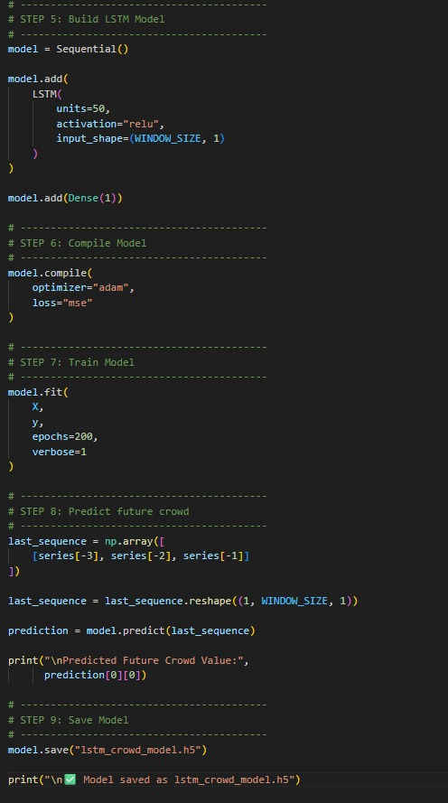
MODEL TRAINING

Slide 16
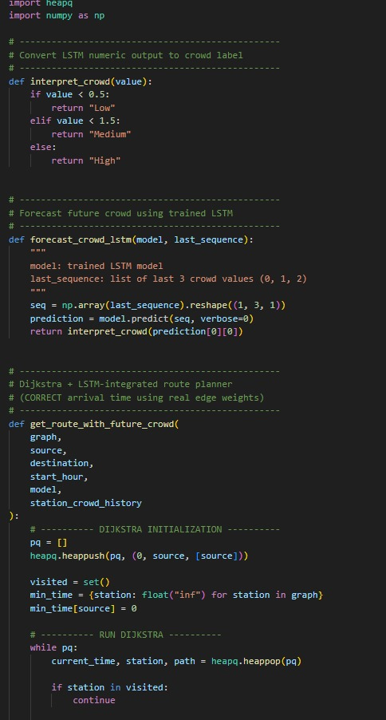
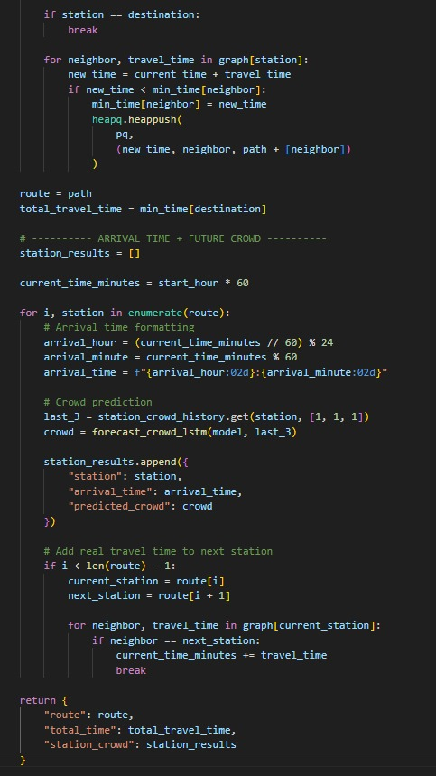
ROUTE PLANNER

Slide 17
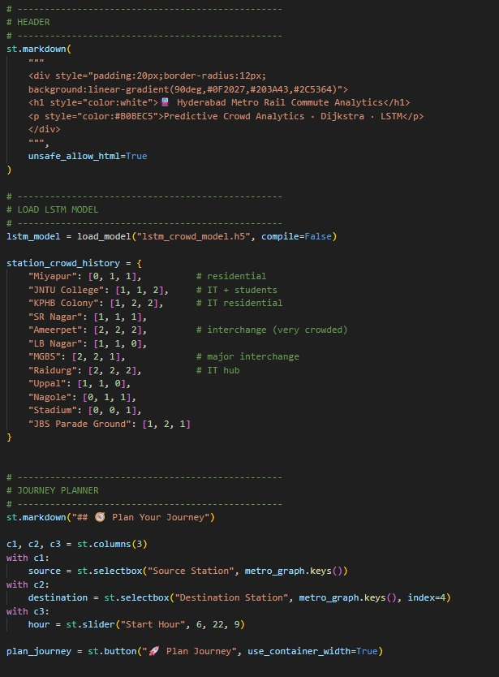
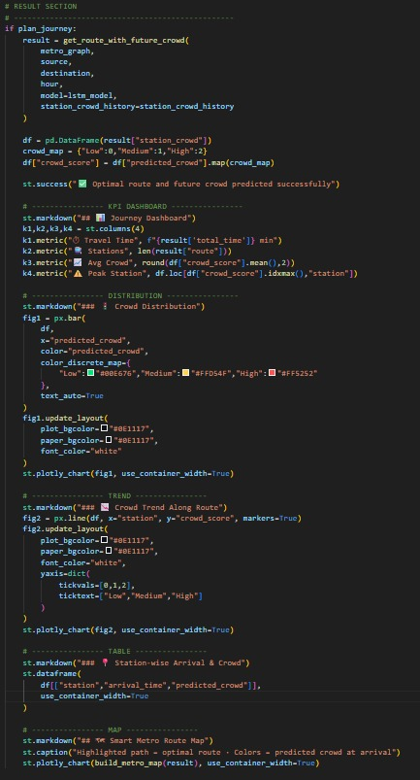

Slide 18
IMPLEMENTATION DEMO

